Slide 1
AUTISM APPROACH SOFTWARE(Autistic student’s Coach )
Kelvin Ndungu Kamau
BIT/0056/14
Supervisor: Mr Dan Khaoya
Supervisor 2: Mr Dennis Gichuki
Department: I.T

Slide 2
Presentation Content
Introduction
Problem statement
Problem justification
Objectives
Scope of the project
Requirement and tools
Methodology
Schedule
Budget

Slide 3
Introduction
As stated by the name, of the project ‘autism approach software’ the software will be useful to people who suffer from autism. This work began by studying autism in detail and the people who suffer from it. The software should be fully interactive with user-parent (supervisor), children (individual suffering from autism), such that the supervisor can log in and schedule tasks to be covered by the child.

Slide 4
Problem statement
Autism spectrum disorders (ASDs) are primarily defined by problems with social interaction and communication, but they are also associated with a complex cognitive profile.
One area of difficulty for children and adults with ASD is problem-solving, or the process of identifying a solution to a puzzle or question where the answer is hidden.
Autism approach software is aimed at helping us approach this defect by integrating QT with graphics ( pictures) to help autistic children relate real life.

Slide 5
Problem justification
The system will aid in growth of the brain of the child affected by ASD, these children attentiveness and communication with other people is normally on a down low but they are drawn to imagery and self-involving activities. The system is therefore going to help communication and interaction between the parent and the child. Through the QTs, the child is able to learn and perform most of the fundamental activities in their day to day life.
The system is also beneficial in improving the ability of the child to socialize with other people by targeting areas in which the child maybe experiencing difficulties while assigning the tasks.

Slide 6
Developers level objectives
To apply the skills taught in class on software development and problem solving in the real world.
To improve my knowledge on programming languages and coding skills.
To develop a system with a user-friendly interface where users can interact freely.
Develop and connect both the front end and back end.

Slide 7
System level objective
To facilitate and aid in the mental growth of children diagnosed with ASD.
To help parents parenting kids with ASD train their children on how to undertake basic tasks that otherwise come naturally for normal kids.

Slide 8
Scope of the project
The project covers psychology department children living with autism such as ECD. Its targeted to be useful to both the children with ASD and tutors to assign tasks to them.
The tasks are designed by the supervisor hence complexity of the tasks will be attributed to the age of the student in the practice.

Slide 9
Functional Requirements too many
User data should input and stored: This system should be able to record and store the user’s information to allow easy log in.
The Supervisor should be able to create task schedules: These are tasks to be undertaken by the Student.
The Supervisor can upload images or other multimedia files: The user is able to upload files to aid in making the allocated tasks more vivid for comprehension.
Ability to add, edit and delete task schedules: The Supervisor should be able to add, edit and remove tasks scheduled for the student when need be.
Student account refresh ability: The Student’s account should be able to refresh and update changes done by the Supervisor in the supervisor’s account.
Registration and creation of user profile: For a user to login, they should register and create a user profile/account, the accounts are either Supervisor account or Students account.
Send messages: Both the Supervisor and Student should be able to communicate via messages.

Slide 10
Non-functional Requirements
User-friendly - The system should not be difficult to learn and use due to its ease interface and easy functionalities.
Reliability - The system should be reliable and would depend on external database.
Portability - The application should be developed using standard software like Java and MySQL.
Availability - This software should be available in the internet for download.
Maintainability - The system used the 2-tier architecture. The 1st tier the GUI, which is said to be front-end and the 2nd tier was the database, which uses MySQL server database which is the back-end.

Slide 11
Software and system requirements
Windows Operating System
DBMS - Mysql
Intel Core i7 1.8 GHz processors – for best performance.
8 GB Ram – to enhance performance by avoiding lags in operations of the development software and OS

Slide 12
Programming tools
Operating System
NetBeans IDE
Apache
JDK
Programming Languages
Java
MySQL

Slide 13
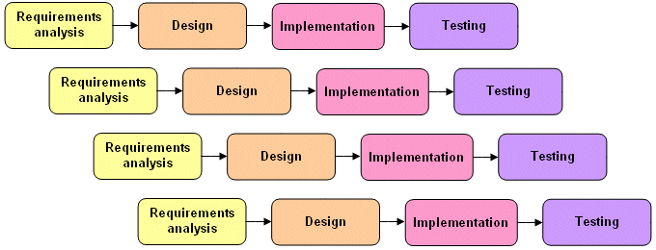
Methodology
The software development methodology intended to use is Incremental Model. This model is a method of software development where the model is designed, implemented and tested incrementally until the product is finished. It involves both development and maintenance. The product is defined as finished when it satisfies all of its requirements. Incremental model combines the elements of the waterfall model with the iterative philosophy of prototyping.

Slide 14
Schedule
ACTIVITY |  | PERIOD: YEAR 2020
SN | ITEM | JAN |  | FEB |  | MAR |  | APR
1 | Requirement gathering
2 | Analysis and design of the system
3 | Coding and debugging
4 | Testing
5 | Analysis and interpretation of result
6 | Documentation
7 | Submission of final report

Slide 15
Budget
Sn | Required Item | Unit | Quantity | Unit Price | Total Price
1 | Laptop(core i7, 8GB RAM, 1.8Ghz, 1TB HDD) | Each | 1 | 45,000 | 45,000
2 | Flash Disk(8GB and above)) | Each | 1 | 1,500 | 1,500
3 | Wireless modem | Each | 1 | 7,000 | 7,000
4 | Internet usage charge | Monthly | 4 | 2,000 | 8,000
5 | Jdk software |  |  |  | Free
6 | NetBeans IDE 8.0 software |  |  |  | Free
7 | Note book | Each | 1 | 100 | 100
8 | Report printing and binding | Each | 2 | 500 | 1,000
9 | Transport |  |  | 2,000 | 2,000
10 | Miscellaneous |  |  | 2,000 | 2,000
 | TOTAL COST |  |  |  | 66,600

